Slide 1
Cognitive Aging

Slide 2
Memory Loss and Aging
Amnesia: Memory loss
Many causes!
  Accidents, strokes, tumors, brain surgery
Amnesia risk increases w/ age
Notes:
Satisfies Learning Objective 1: Summarize the descriptions of amnesic patients and describe what they have in common and how they differ.
Alzheimer’s disease: The most common form of amnesia, with an approximate 360,000 cases every year.
Causes of amnesia:
Frequently results from brain damage that occurs in strokes or motor vehicle accidents.
It can also be the result of tumors, near-drowning experiences (apoxia), brain surgery, bullet wounds, and other damage to the brain.
Psychological trauma and psychiatric conditions can also lead to memory impairment.

Slide 3
What Is Amnesia?
Amnesia is broad!
Two general types:
  Retrograde vs. anterograde
Neurological amnesia:
  Results from physical destruction of brain tissue
  Could be retrograde or anterograde!
Notes:
Satisfies Learning Objective 1: Summarize the descriptions of amnesic patients and describe what they have in common and how they differ.
Amnesia: Memory deficits acquired through brain damage.
Classification: Different disorders, with memory loss as a common factor, can be classified as amnesia.
Memory loss:
The major deficit is in encoding new information into episodic memory.
Others affect retrieval from episodic memory.
Amnesia may also affect access to semantic memory and working memory, and executive control of memory.
Neurological amnesia: Results from physical destruction of different regions of the brain.

Slide 4
Anterograde Amnesia
Inability to form new memories after brain damage
Learning new information is difficult
Deficits can be quite specific
Damage is usually to the hippocampus and/or medial temporal lobes
Notes:
Satisfies Learning Objective 2: Contrast the different varieties of amnesia and how they map onto different human memory systems.
Anterograde amnesia:
An inability to form new memories following brain damage.
It can vary from mild impairment to the severe impairment seen in patients like HM.
Learning new information, episodic or semantic, becomes difficult.
Resultant deficits:
Some deficits are quite specific, that is, the person has difficulty in learning new information and encoding episodic events, while other aspects of memory remain intact.
Damage in the brain tends to be in the hippocampus and medial temporal lobes.
Hippocampus:
An area of the brain associated with learning and memory.
Damage can cause anterograde amnesia.
Medial temporal lobes:
A cortical area of the brain in the temporal lobes associated with learning and memory.
Damage can cause anterograde amnesia.
Damage can also be in the mammillary bodies of the diencephalon.
Mammillary bodies:
A subcortical region of the brain associated with learning.
Damage can cause anterograde amnesia.
Amnesic syndrome: Specific impairment of encoding new information into both episodic and semantic memory while most other cognitive functions remain intact.
Difference between hippocampal and diencephalon damages:
Patients with damage to the hippocampus and to the surrounding medial temporal lobes will show deficits on both recall and recognition tests.
Patients with damage to areas of the diencephalon will show relatively preserved performance on tests of recognition.

Slide 5
Retrograde Amnesia
Lost ability to retrieve prior events
Example: Case of Trevor Rees-Jones
  Only survivor of the car accident that killed Princess Diana
  Full recovery; no long-term physical or cognitive deficits
  No memory of the accident
  Also missing memory for the events several hours before the accident
Notes:
Satisfies Learning Objective 2: Contrast the different varieties of amnesia and how they map onto different human memory systems.
Retrograde amnesia:
When patients lose the ability to retrieve memories of events prior to brain damage.
In most cases, the inability to retrieve from memory is limited to episodic memory.
Typically, it is not complete.
The period from which memories cannot be recalled may be small and the consequences relatively inconsequential, or it may stretch back for many years.
The case of Trevor Rees-Jones:
He was the only survivor of the tragic car crash that killed Princess Diana.
Although he made a full recovery from the auto accident, with no long-term deficits in his physical or cognitive abilities, the head injury did create a window of retrograde amnesia from the time of the accident to several hours before.
Loss of memory:
Occurs for events closest to the point of brain damage.
Ribot’s law: Newer memories will be more affected by retrograde amnesia than older memories.
Consolidation: A neurological process whereby memory traces are made permanent in a person’s long-term memory.
The period of retrograde amnesia can be quite short in relatively minor injuries.
Existing research:
Lynch and Yarnell observed that football players, who suffered from concussions during games, could no longer remember the play in which they had gotten injured.
In case of permanent brain damage, the retrograde period can remain lengthy and unchanged for the rest of the person’s life.

Slide 6
Memory loss and Aging
Age
  The amount of time (typically in years) following birth, chronological
Is this appropriate?
  Number of gray hairs
  Number of wrinkles
  Changes to BMI

Slide 7
What is Age?
Aging causes nothing
  “Aging” is a process that correlates with the passage of time
  Aging is not causation, though often assumed
  Not a tangible object or structure (i.e., no random assignment)
We use Chronological Age (Time) to infer aging effects

Slide 8
Developmental Trajectories
Cognitive Factor X
Chronological Age

Slide 9


Slide 10
Why declines in episodic memory?
Attentional declines
  Deliberate mental effort must be allocated in order to remember something
Ineffective Retrieval Cues
  We can remember anything with the right cues (reminders)!
  As we age, our ability to bring cues online declines
  Example: Tip-of-the-tongue phenomenon

Slide 11
Age Theories of Attention
Why are there age-related differences?
  1.) Processing Resources Hypothesis
  As we get older, we generally have fewer processing resources available
    Processing resources = number of mental operations

Slide 12
Age Theories of Attention
Why are there age-related differences?
  2.) Cognitive Slowing (Speed of Processing Hypothesis; Salthouse, 1996)
    General slowing of cognitive processing
    Older adults are 1.5 times slower on responding on some tasks (Myerson et al., 1992; Salthouse, 1985)

Slide 13
Dementia
No a single disease, used more to describe symptoms
  1.) Huntington’s disease
    Strong genetic base
  2.) Parkinson’s disease
  3.) Head trauma
  4.) Alzheimer’s Disease

Slide 14
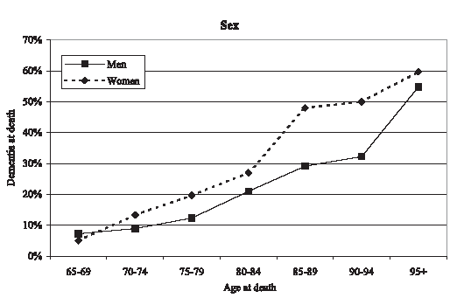
5.2 million Americans 65+ have been diagnosed with dementia-like symptoms (2016 estimate)
By the age of 95 100% of individuals at autopsy have pathology consistent with Alzheimer’s Disease (Morris, 1995)

Slide 15
Alzheimer’s Disease (AD)
Most common form of dementia
  Progressive
  Degenerative
  Fatal
    In about 60% of cases
  Can only be diagnosed post mortem
    Changes in brain structure are microscopic
    Dementia of the Alzheimer’s Type (DAT)
    Affects 24 Million worldwide, estimated to affect 80 million by 2040 (Bateman et al., 2011)

Slide 16
Alzheimer’s Disease (1 of 5)
Typical pattern of deterioration:
  Memory decline is first symptom
  Followed by general cognitive problems
  In the latest stages, physical systems rapidly decline
Earliest stages of disease:
  Patient recognizes that their memory “isn’t what it used to be”
  Hard to distinguish from healthy aging
  Neurotesting can distinguish (deficits in WM)
Notes:
Satisfies Learning Objective 4: Explain what causes Alzheimer’s Disease is and how it develops in terms of its debilitating symptoms for people suffering from it.
Alzheimer’s disease:
A dementia-type illnesses that are more common in older adults than in younger adults.
It is caused by amyloid plaques and neurofibrillary tangles throughout the brain.
Memory is the first deficit detected in this disease.
It is the sixth leading cause of death in the United States.
Typical pattern of deterioration:
Memory decline is the first symptom.
These are followed by more general cognitive problems.
In the latest stages, physical systems decline rapidly.
Earliest stages of disease:
In the earliest stage of the disease, the patient will recognize that his or her memory is “not what it used to be.”
In this stage, memory deficits may be difficult to distinguish behaviorally from normal age-related declines in memory.
Neuropsychological tests can often distinguish between the two, with Alzheimer’s patients showing deficits in working memory performance.
Patients also do not show normal recency effect on free-recall tasks.

Slide 17
Alzheimer’s Disease (2 of 5)
Intermediate stages.
  Cognitive deficits increase
  More anterograde amnesia
  Problems w/ language and decision making
Increase in retrograde amnesia.
  Temporal gradient: More recent information is lost first
Notes:
Satisfies Learning Objective 4: Explain what causes Alzheimer’s Disease is and how it develops in terms of its debilitating symptoms for people suffering from it.
Intermediate stages:
Mounting of cognitive deficits.
Stronger growth of anterograde amnesia.
Retrograde amnesia may also occur.
Problems in decision-making and language may arise.
Motor deficits are also experienced.
Increase in retrograde amnesia: Characterized by a temporal gradient, with more recent information being lost before older information.
Late stages of disease:
With motor movement now difficult, the patient is completely dependent on caregivers.
Memory declines to the point that the patient no longer appears to recognize even close family members.
In many cases, the patient will no longer respond to hearing his or her own name.
The patient may also lose all access to language and be unable to either speak or understand others.
Patient usually dies of external factors, such as pneumonia, rather than the Alzheimer’s disease itself.

Slide 18
Alzheimer’s Disease (3 of 5)
Late stages of disease:
  Motor problems/difficulty with movement
  Patient no longer recognizes close family members
  No longer responds to their own name
  Patient dies of external factors rather than AD itself
Notes:
Late stages of disease:
With motor movement now difficult, the patient is completely dependent on caregivers.
Memory declines to the point that the patient no longer appears to recognize even close family members.
In many cases, the patient will no longer respond to hearing his or her own name.
The patient may also lose all access to language and be unable to either speak or understand others.
Patient usually dies of external factors, such as pneumonia, rather than the Alzheimer’s disease itself.

Slide 19
Cognitive Symptoms
Gradual changes in cognitive functioning:
  Declines in attention
  Declines in memory
  Declines in judgment/decision making
  Disorientation in time/space
Does attention moderate all of these other behaviors?

Slide 20
Declines in Attention
Stroop Task
  Errors on Incongruent trials predict DAT conversion (Hutchison et al., 2010)
  The Stroop effect (slower RTs on incongruent trials) does not
CVOE Switch Task
  Errors on Switch trials predict DAT conversion (Huff et al., in prep)
  Switch costs in RT, do not
Trials that are the most difficult are sensitive to breakdowns in attentional control

Slide 21
Other Symptoms
Sundowning (“as the sun goes down”)
  Symptoms of AD are generally worse in the evening than in the morning
Declines in Activities of a Daily Living (ADLs)
  Personal hygiene, toileting, eating, transfer (walking/mobility)
Changes in personality
Inappropriate social behaviors

Slide 22
Characteristics of AD
Abnormal/Rapid Cell Death
  Frontal Lobe
  Hippocampus
  Cortex

Slide 23
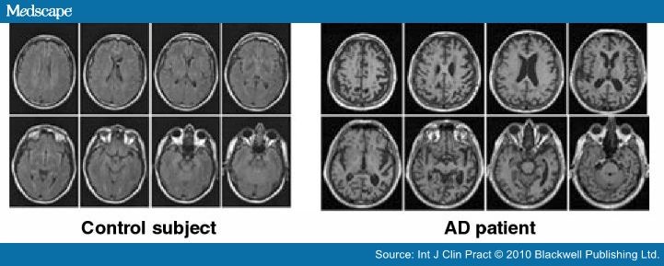
Characteristics of AD

Slide 24
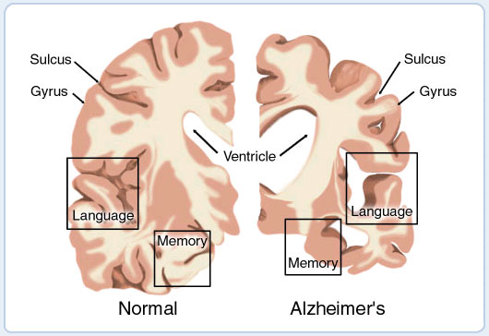

Slide 25
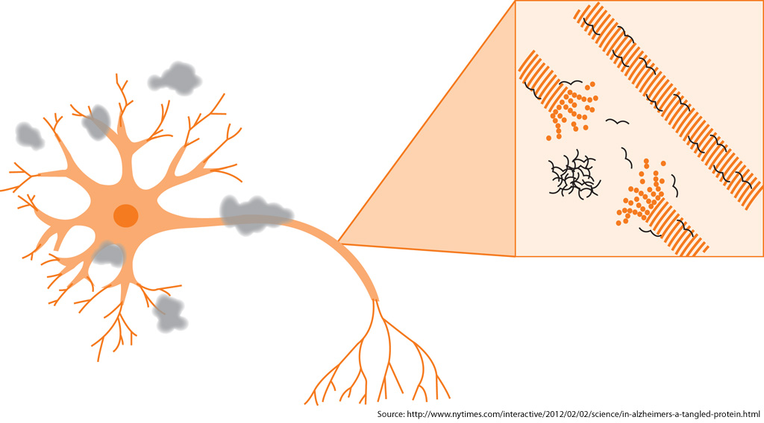

Slide 26
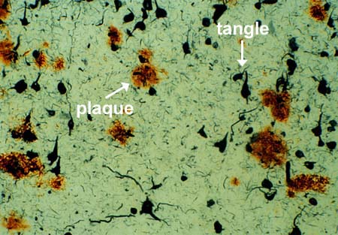
Characteristics of AD
Neuritic plaques
  Beta-amyloid plaques
  Peptide that is surrounded by dead or dying neurons
  Marker for AD

Slide 27
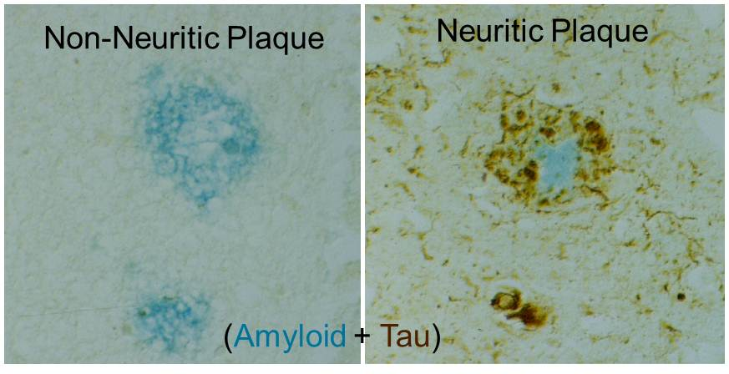
Neuritic Plaques

Slide 28
Alzheimer’s Disease (3 of 4)
Causes of Alzheimer’s Disease
Genetic component: Risk is 50% for identical twins if one twin has already developed it
Changes to the brain’s cholinergic system:
  Brain has difficulty producing acetylcholine, which is important for learning and memory
Notes:
Satisfies Learning Objective 4: Explain what causes Alzheimer’s Disease is and how it develops in terms of its debilitating symptoms for people suffering from it.
Genetic component:
It increases the likelihood getting it someday than someone without a close relative with Alzheimer’s disease.
The risk of developing Alzheimer’s disease is 50% for a person whose identical twin has already developed it.
Incredible stress on the brain:
Neural degeneration in the cerebral cortex gradually spreads to subcortical areas.
Dense amyloid plaques form throughout the cortex.
Amyloid plaques: Masses of unnecessary proteins that interfere with normal brain function.
Neurofibrillary tangles: The twisting of amyloid plaques around neurons, which causes destruction of those neurons.
Changes to the brain’s cholinergic system: The brain has difficulty producing the neurotransmitter acetylcholine, used in many of its learning and memory circuits.

Slide 29
Characteristics of AD
Neurofibrillary tangles
  Misfolded proteins (filaments) within the neuron
    Direct relationship with dementia is unknown
    Marker for AD

Slide 30
Alzheimer’s Disease (4 of 4)
Treatment of Alzheimer’s Disease
Prevention: Not 100% guaranteed
  Intellectually challenging activities may lower risk
  Active social life is also related to lower risk
  Healthy, low cholesterol diet
Treatment:
  Drugs attempt reduce the rate that acetylcholine is broken down
  Drug effects are temporary
  Current research emphasizes drugs that will inhibit amyloid plaques
Notes:
Satisfies Learning Objective 4: Explain what causes Alzheimer’s Disease is and how it develops in terms of its debilitating symptoms for people suffering from it.
Prevention:
Prevention is not 100% guaranteed.
Lifelong involvement in intellectually challenging activities lowers the risk of Alzheimer’s disease.
An active social life is also associated with a lower risk of developing Alzheimer’s disease.
These activities spur the growth of synapses in the brain.
Healthy, low-cholesterol diets are correlated with lower rates of the disease.
Hypertension, high cholesterol, diabetes, and smoking are all correlated with higher rates of Alzheimer’s disease.
Treatment:
Alzheimer’s drugs work by reducing the rate at which acetylcholine is broken down (destroyed) in the brain.
This will lead to temporary improvements in memory and cognitive processes, although, in the long run, the drugs cannot slow the process down.
Ongoing research focuses on finding drugs that will inhibit, reverse, or prevent the forming of the amyloid plaques.
Mild magnetic stimulation of the brain can cause temporary improvements of cognitive function in Alzheimer’s patients.

Slide 31
Drug Treatments
Proactive drug types, prevention of misfolded tangles and eliminating plaques when detected early
  Bapineuzumab – Pfizer (2012)
    Drug failed, Placebo > Experimental Drug
  Gantenerumab – Roche (2015)
    Drug failed, Placebo = Experimental Drug
  Solanezumab – Lily (2016)
    Drug failed, Placebo = Experimental Drug
Why so many failures?

